Slide 1
Cycling Club Registration App
Demo the usage of delegate

Slide 2
Objective
Demo code reuse
Demo design flexibility

Slide 3
Overview
SQLite DB Browser
Read/Modified
Registration Form
Pass Validation?
SQLite
Yes
Store to
Main view
No
Enter again
User
Redirect to
Login Form
No
Valid info?
Yes
Welcome View
End
SQLite DB Browser Installer: https://sqlitebrowser.org/dl/

Slide 4
How to run this project
Install the following NuGet Package:
Microsoft.EntityFrameworkCore.Sqlite (refer slide#6)
Microsoft.EntityFrameworkCore.Tools (refer slide#9)
Run the following command at NuGet Package Console (refer slide#10)
Add-Migration FirstCreate
Update-Database
Debug the application to run

Slide 5
Models – User class
No. | Property Name | Type | Remark
1 | Id | Int | Auto increase
2 | FirstName | String
3 | LastName | String
4 | Password | String
5 | DateOfBirth | DateTime
6 | PhoneNumber | String
7 | AddressFirstLine | String
8 | AddressSecondLine | String
9 | AddressCity | String
10 | Postcode | String
11 | EmailAddress | String

Slide 6
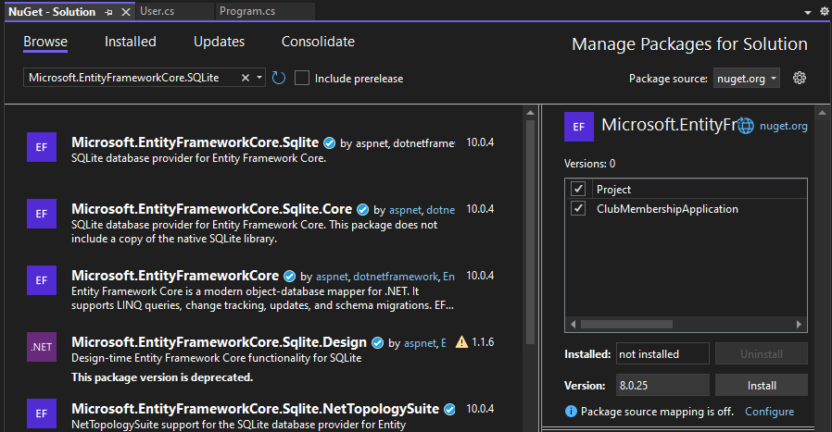
Installing NuGet Package
Tools > Nuget Package Manager > Manage NuGet Package Manager for Solution …
Select this
Tick
Choose correct version before install

Slide 7
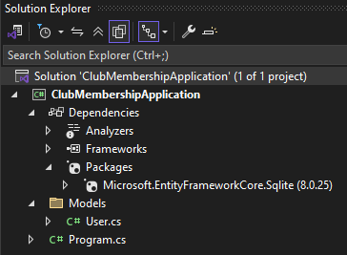
Validate the Package

Slide 8
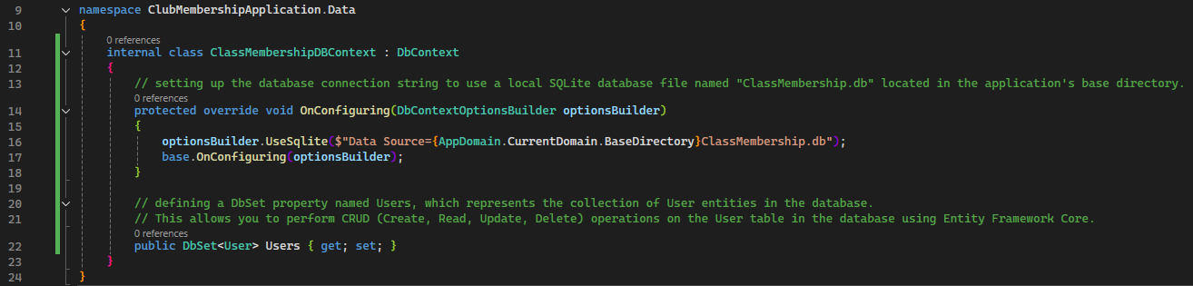
DbContext – create the connection to database

Slide 9
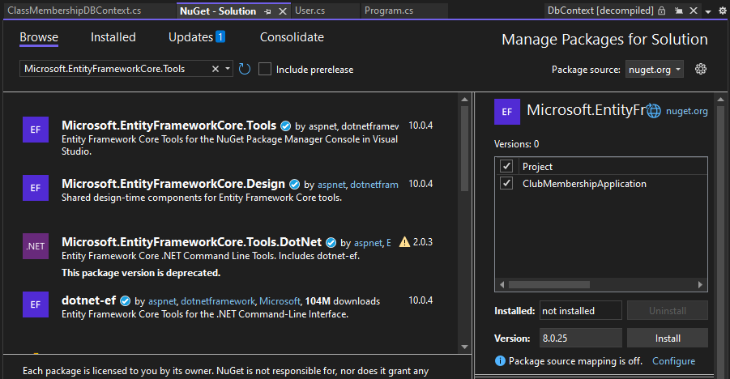
Installing NuGet Package for DB Migration
Select this
Tick
Choose correct version before install
Refer Validate the Package slide on how to validate if installation success

Slide 10
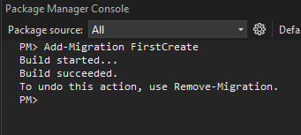
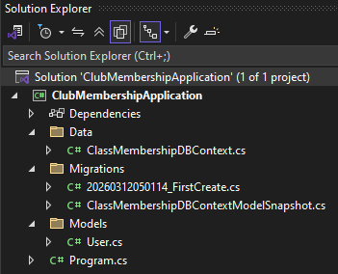
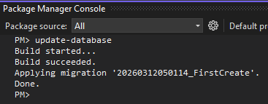
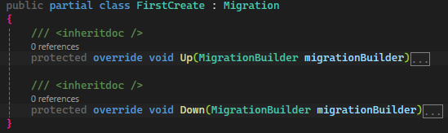
Migration – version control for Db schema
Tools > Nuget Package Manager > Package Manager Console
Created the Migrations class
Create the table
Create user table
Drop user table

Slide 11
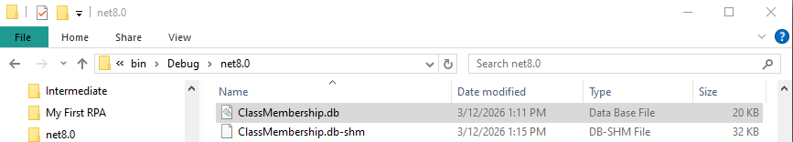
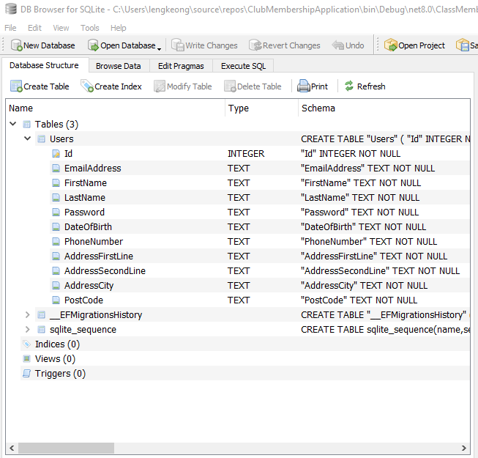
Check the Database
Browse with DB Browser

Slide 12
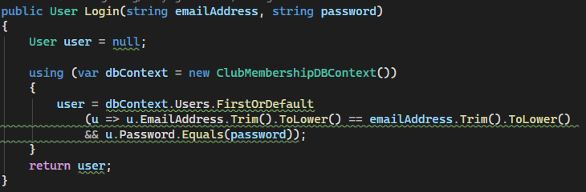
LoginUser implement ILogin
Return user details if found

Slide 13
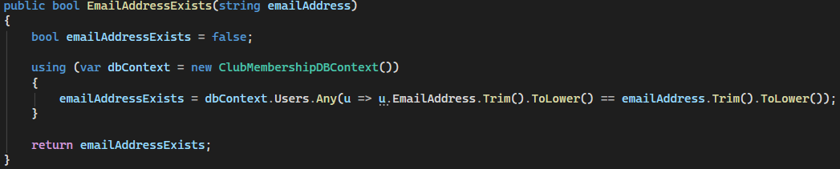
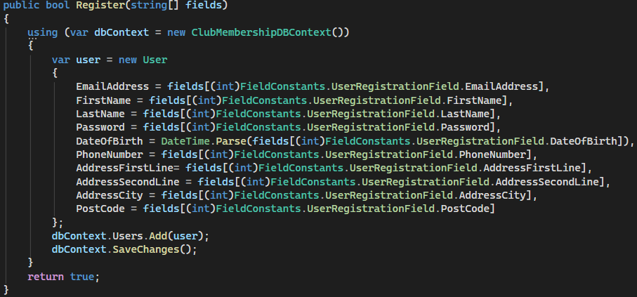
RegisterUser implement IRegister
Check if Email was used
Save the user to db

Slide 14
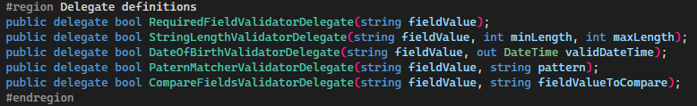
FieldValidatorAPI – CommonFiledValidatorFunctions
This delegate can reference any method that take a single string parameter and return bool
Delegate Definitions

Slide 15
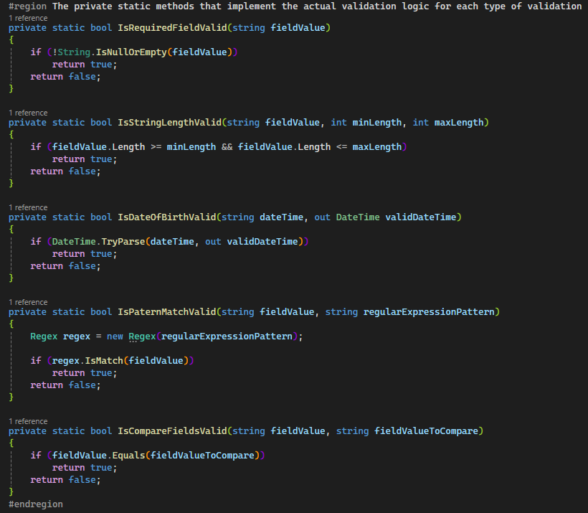
FieldValidatorAPI – CommonFiledValidatorFunctions
Methods that implement the actual validation logic

Slide 16
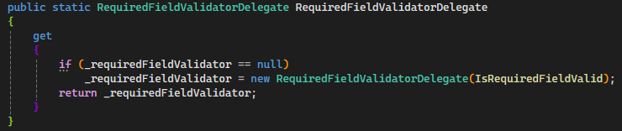
FieldValidatorAPI – CommonFiledValidatorFunctions
The reference (variable)
Prevent the user from pointing the delegate to other function and only use the function controlled in get property.
Lazy Loading: only create the instance when someone calls the get for the first time.
The method
Lazy initialization of the delegate instance. This approach also known as Singleton as it only ONE instance created. Thus, it always return the instance which is created at first time.

Slide 17
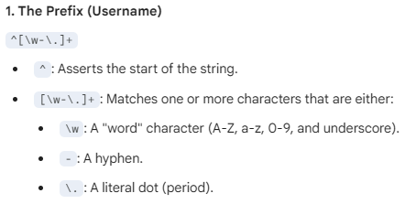

FieldValidatorAPI – CommonRegularExpressionValidationPatterns

Slide 18
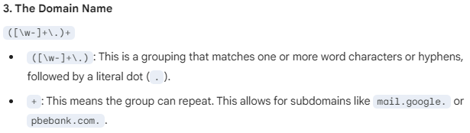
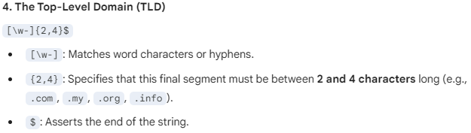
FieldValidatorAPI – CommonRegularExpressionValidationPatterns

Slide 19
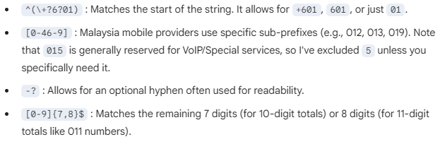
FieldValidatorAPI – CommonRegularExpressionValidationPatterns
-? Means allow zero or one hyphens
-* Means allow zero or more hyphens

Slide 20

FieldValidatorAPI – CommonRegularExpressionValidationPatterns
Without ^ and $ ,
user can enter more than 5 digits or as long as there were 5 digits match in between
^ and $ are known as Anchors

Slide 21
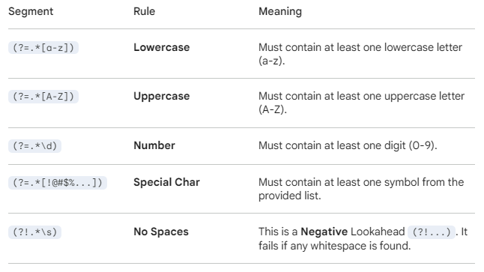
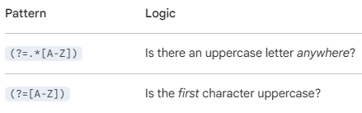
FieldValidatorAPI – CommonRegularExpressionValidationPatterns
?= is the Lookahead syntax.
.* means any character appear 0 or more times

Slide 22
Overview
Register or Login?
Factory
MainView
Register
UserRegistrationView
Login
All the views will implement IView interface
UserLoginView
Success login?
Display error message
No
WelcomeUserView
Yes

Slide 23

IView interface
Provide 1 method and 1 interface. Both only got definition without implementation

Slide 24
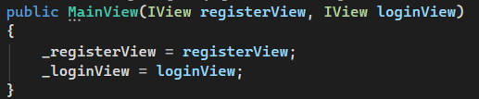
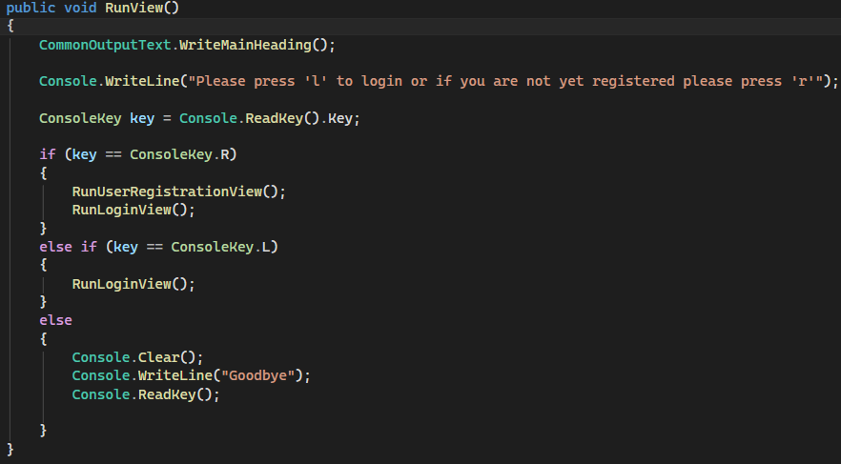
MainView
Construct with 2 interfaces of IView type.
Return as null as no validation required
Write the RunView implementation

Slide 25

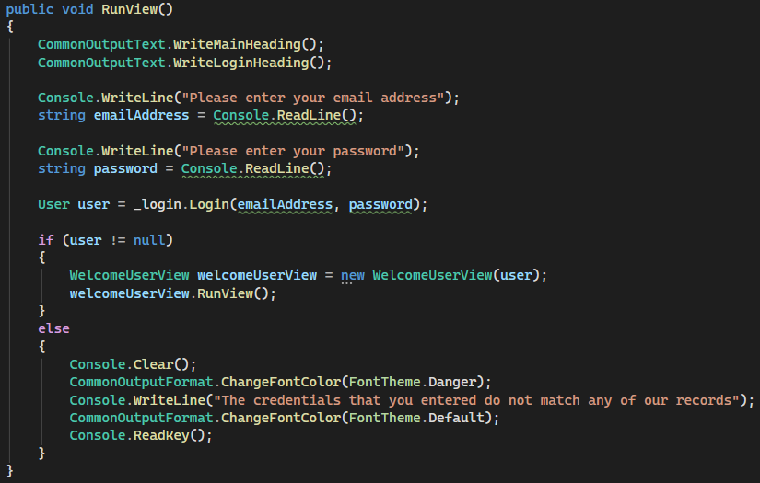
UserLoginView
Construct with 1 interfaces of ILogin type.
Return as null as no validation required
Write the RunView implementation

Slide 26


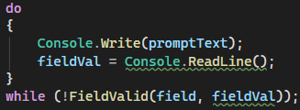
UserRegistrationView
Construct with 2 interfaces, IRegister and IFieldValidator.
Return FieldValidator
RunView show the question
Store the user input if correct
GetInputFromUser and trigger validation
Repeat if user input incorrect
RegisterUser store user data into db
Register the user

Slide 27
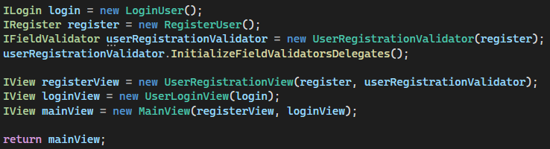
Factory
Instantiate the main view

